Slide 1
SORTING AND
SEARCHING
© A+ Computer Science - www.apluscompsci.com

Slide 2
Java Sorts
int[] ray = {13,6,17,18,2,-5};
Arrays.sort(ray);
for(int i = 0; i < ray.length; i++)
{
out.println(ray[i]);
}
OUTPUT-5
2
6
13
17
18
© A+ Computer Science - www.apluscompsci.com
Notes:
sort() will naturally order the items in an array.

Slide 3
Java Sorts
ArrayList<Integer> ray;
ray=new ArrayList<Integer>();
ray.add(21);
ray.add(2);
ray.add(13);
ray.add(-1);
ray.add(3);
Collections.sort(ray);
for(int num : ray )
out.println(num);
OUTPUT-1
2
3
13
21
© A+ Computer Science - www.apluscompsci.com
Notes:
sort() will naturally order the items in the Collection.

Slide 4
Divide and Conquer
Algorithms
0 ( N Log2N )
© A+ Computer Science - www.apluscompsci.com

Slide 5
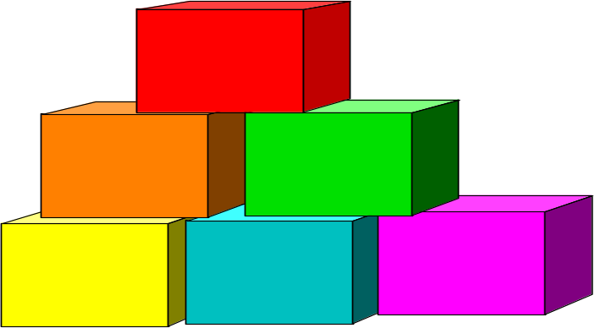
Divide and Conquer
32
16
16
8
8
8
8
4
4
4
4
4
4
4
4
© A+ Computer Science - www.apluscompsci.com

Slide 6

The Quick Sort
© A+ Computer Science - www.apluscompsci.com

Slide 7
Quick Sort
Quick sort finds a pivot value. All numbers
greater than the pivot move to the right and
all numbers less move to the left.
This list is then chopped in two and the
process above is repeated on the smaller sections.
http://www.cs.armstrong.edu/liang/animation/web/QuickSortPartition.html
© A+ Computer Science - www.apluscompsci.com

Slide 8
Quick Sort
1 . . 32
1 . . 22
23 . . 32
1 . . 19
20. . 22
23 . .25
26 . . 32
Quick sort chops up the list into smaller pieces
as to avoid processing the whole list at once.
© A+ Computer Science - www.apluscompsci.com

Slide 9
quickSort Algorithm
void quickSort(Comparable[] stuff, int low, int high)
{
if (low < high)
{
int spot = partition(stuff, low, high);
quickSort(stuff, low, spot);
quickSort(stuff, spot+1, high);
}
}
Arrays.sort( ) uses the quickSort if sorting primitives.
© A+ Computer Science - www.apluscompsci.com

Slide 10
partition Algorithm
int partition(Comparable[] stuff, int low, int high)
{
Comparable pivot = stuff[low];
int bot = low-1;
int top = high+1;
while(bot<top) {
while (stuff[--top].compareTo(pivot) > 0);
while (stuff[++bot].compareTo(pivot) < 0);
if(bot >= top)
return top;
Comparable temp = stuff[bot];
stuff[bot] = stuff[top];
stuff[top] = temp;
}
}
© A+ Computer Science - www.apluscompsci.com

Slide 11
Quick Sort in Action
Original List
Integer[] ray = {90,40,20,30,10,67};
pass 1 - 67 40 20 30 10 90
pass 2 - 10 40 20 30 67 90
pass 3 - 10 40 20 30 67 90
pass 4 - 10 30 20 40 67 90
pass 5 - 10 20 30 40 67 90
© A+ Computer Science - www.apluscompsci.com

Slide 12
The quickSort has a N*Log₂N BigO.
The quickSort method alone has a Log₂N run time, but cannot be run without the partition method.
The partition method alone has an N run time and can be run without the quickSort method.
quickSort
Partition
© A+ Computer Science - www.apluscompsci.com

Slide 13

The Merge Sort
© A+ Computer Science - www.apluscompsci.com

Slide 14
Merge Sort
Merge sort splits the list into smaller sections
working its way down to groups of two or one.
Once the smallest groups are reached, the merge
method is called to organize the smaller lists.
Merge copies from the sub list to a temp array.
The items are put in the temp array in sorted order.
http://www.cs.armstrong.edu/liang/animation/web/MergeList.html
© A+ Computer Science - www.apluscompsci.com

Slide 15
Merge Sort
1 . . 32
1 . . 16
17 . . 32
1 . . 8
9. . 16
17 . .25
26 . . 32
Merge sort chops in half repeatedly to avoid processing the whole list at once.
© A+ Computer Science - www.apluscompsci.com

Slide 16
mergeSort Algorithm
void mergeSort(Comparable[] stuff, int front, int back)
{
int mid = (front+back)/2;
if(mid==front) return;
mergeSort(stuff, front, mid);
mergeSort(stuff, mid, back);
merge(stuff, front, back);
}
Collections.sort( ) uses the mergeSort.
Arrays.sort( ) uses mergeSort for objects.
© A+ Computer Science - www.apluscompsci.com

Slide 17
void merge(Comparable[] stuff, int front, int back)
{
Comparable[] temp = new Comparable[back-front];
int i = front, j = (front+back)/2, k =0, mid =j;
while( i<mid && j<back) {
if(stuff[i].compareTo(stuff[j])<0)
temp[k++]= stuff[i++];
else
temp[k++]= stuff[j++];
}
while(i<mid)
temp[k++]= stuff[i++];
while(j<back)
temp[k++]= stuff[j++];
for(i = 0; i<back-front; ++i)
stuff[front+i]=temp[i];
}
Merge
W/Objects
© A+ Computer Science - www.apluscompsci.com

Slide 18
Merge Sort in Action
Original List
Integer[] stuff = {90,40,20,30,67,10};
pass 0 - 90 20 40 30 67 10
pass 1 - 20 40 90 30 67 10
pass 2 - 20 40 90 30 10 67
pass 3 - 20 40 90 10 30 67
pass 4 - 10 20 30 40 67 90
© A+ Computer Science - www.apluscompsci.com

Slide 19
The mergeSort has a N*Log₂N BigO.
The mergeSort method alone has a Log₂N run time, but cannot be run without the merge method.
The merge method alone has an N run time and can be run without the mergeSort method.
mergeSort
Merge
© A+ Computer Science - www.apluscompsci.com

Slide 20
Speed
© A+ Computer Science - www.apluscompsci.com

Slide 21
Runtime Analysis
for( int i=0; i<20; i++)
System.out.println(i);
for( int j=0; j<20; j++)
for( int k=0; k<20; k++)
System.out.println(j*k);
Which section of code would execute the fastest?
© A+ Computer Science - www.apluscompsci.com

Slide 22
Runtime Analysis
ArrayList<Integer> iRay;
iRay = new ArrayList<Integer>();
for( int i=0; i<20; i++)
iRay.add(i);
ArrayList<Double> dRay;
dRay = new ArrayList<Double>();
for( int j=0; j<20; j++)
dRay.add(0,j);
Which section of code would execute the fastest?
© A+ Computer Science - www.apluscompsci.com

Slide 23
General Big O Chart
for N^2 Sorts
Name Best Case Avg. Case Worst
Selection Sort O(N²) O(N²) O(N²)
Bubble Sort O(N) O(N²) O(N²)
Insertion Sort O(N) (@) O(N²) O(N²)
@ If the data is sorted, Insertion sort should only make one pass
through the list. If this case is present, Insertion sort would have
a best case of O(n).
© A+ Computer Science - www.apluscompsci.com

Slide 24
General Big O Chart
for NLogN Sorts
Name Best Case Avg. Case Worst
Merge Sort O(N log₂ N ) O(N log₂ N ) O(N log₂ N )
QuickSort O(N log₂ N ) O(N log₂ N ) O(N²) (@)
@ QuickSort can degenerate to N². It typically will degenerate on
sorted data if using a left or right pivot. Using a median pivot will
help tremendously, but QuickSort can still degenerate on certain
sets of data. The split position determines how QuickSort behaves.
© A+ Computer Science - www.apluscompsci.com

Slide 25
Continue work
on Labs
© A+ Computer Science - www.apluscompsci.com

